Slide 1

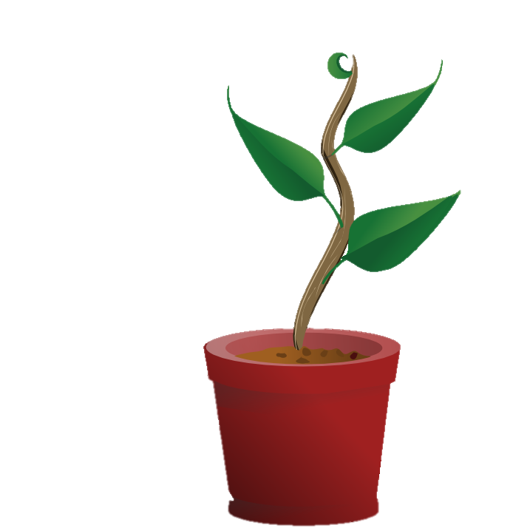
Plant Parenthood
Our goal is to provide education and assistance for basic home plant-care.

Slide 2
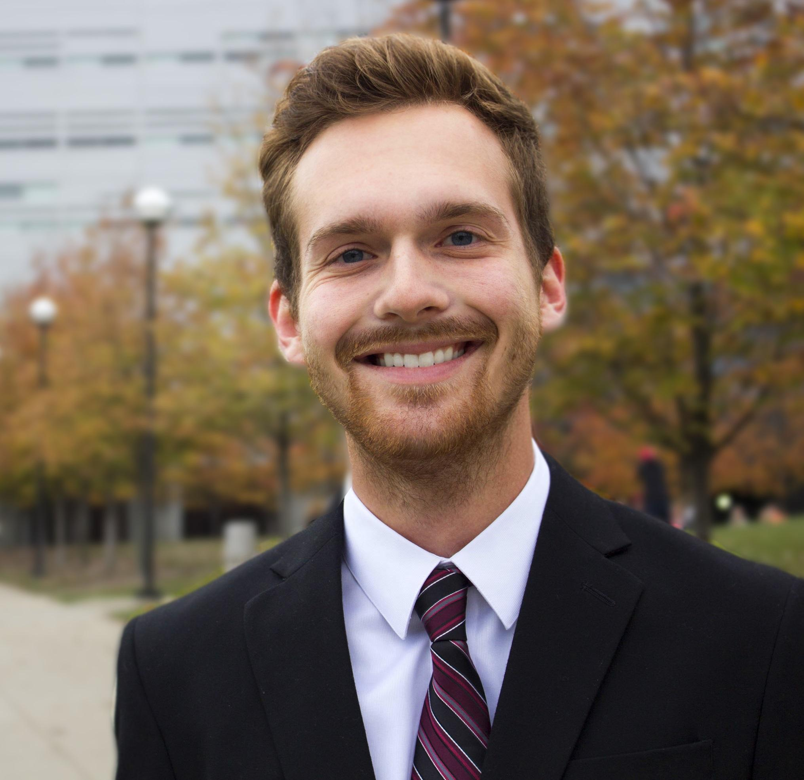
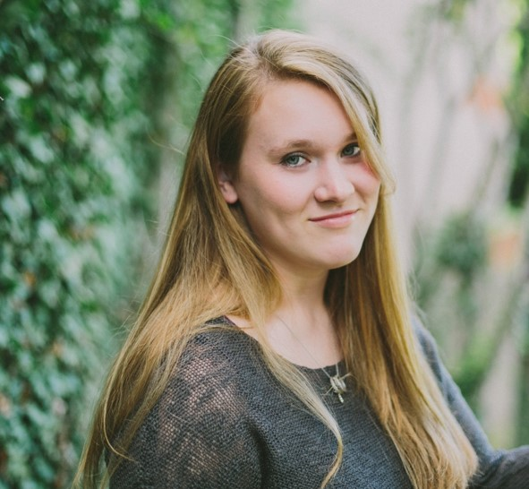
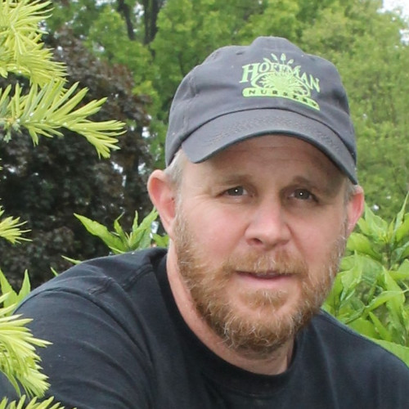
Plant Parenthood Team
Max Frisch
Rachael Chandler
Prof. James Hansel
Phone: (513) 706 – 2507
Email: frischmf@mail.uc.edu
Phone: (937) 789 – 7032
Email: chandlra@mail.uc.edu
Phone: (513) 203 – 7604
Email: hanselj@greatoaks.com

Slide 3
Project Description
Plants can be difficult to take care of - they require consistent attention, different species need different care, and unless you are familiar with plants you may not know what it is that a plant needs to be healthy or what is lacking in the care you provide.
We seek to create a holistic solution to this problem, by creating an interactive system that supplements the caretaking process and provides helpful insight to improve the health of your plant.
We aim to monitor plant health and provide the plant-owner with relevant caretaking information. This will be accomplished using a Raspberry Pi to measure different metrics related to plant health (exposure to light, rhizosphere moisture level, pH, and relative humidity), and then will be analyzed to provide the user with helpful feedback regarding plant health and advice for future care.

Slide 4
User Stories
As someone new to plant-care, I want to receive in the moment notice of my plant’s needs so that I can learn how to care for it better.
As someone experienced with plant-care, I want to analyze in greater detail my plant’s environment so that I can implement more effective care and foster better growth.
As a botanist, I want to monitor the overall health of my greenhouse so that I can address issues with specific areas of my garden.

Slide 5
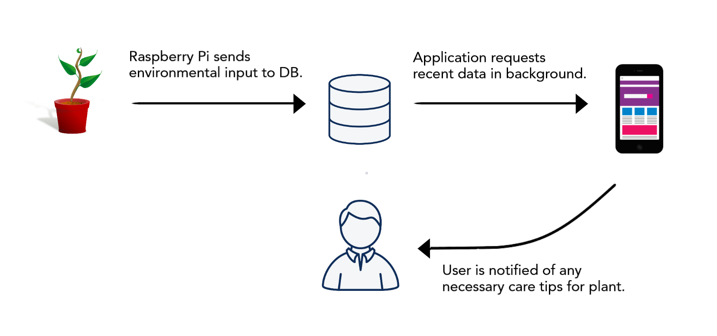
Design Diagram Level I

Slide 6
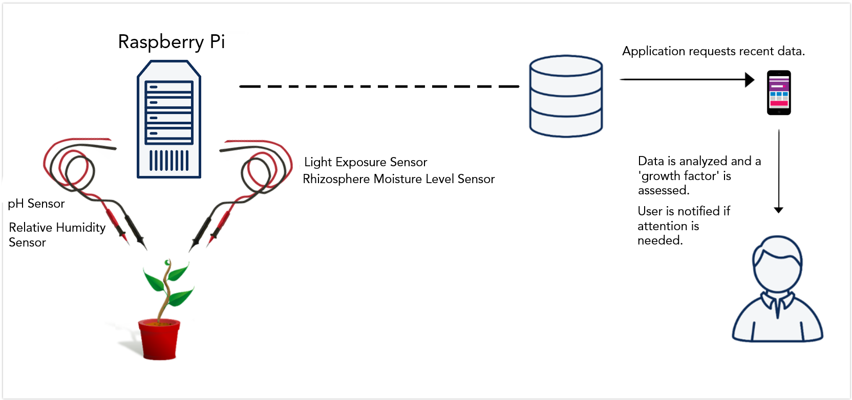
Design Diagram Level II

Slide 7
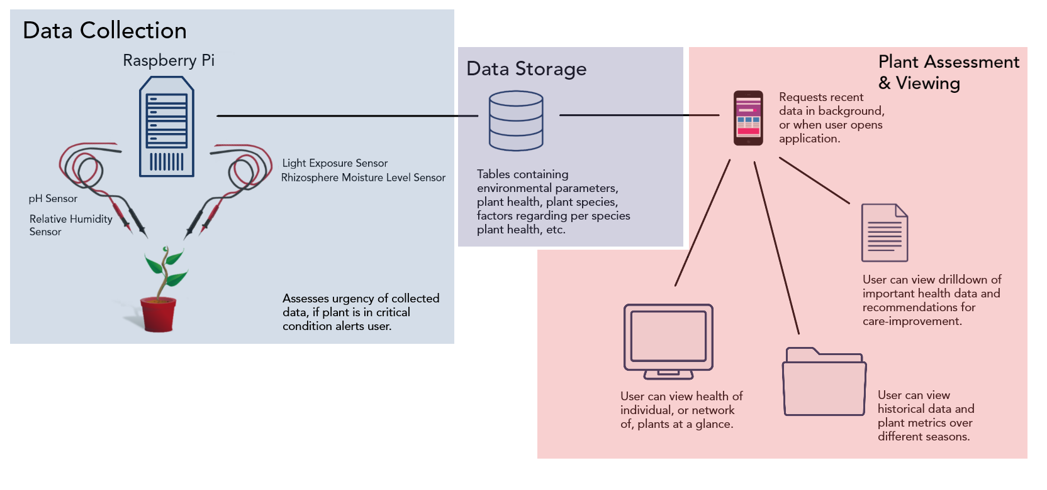
Design Diagram Level III

Slide 8
Project Constraints
Financial
Hardware costs
Raspberry Pi - ~$40
Soil moisture sensor - ~$10 - $15
Humidity sensor - ~$10
Light intensity sensor - ~$9
Soil pH detector: ~$10
Using free software
Testing supplies
Pots, plants, soil, etc.
~$40
Total Estimated Cost: $125
Professional
We are well equipped to handle the programming
We know little about plant life and care
We have decided to work with a professor in the horticulture department to supplement our plant knowledge

Slide 9
Current State of Project
Research Hardware and Software
Raspberry Pi v. Arduino
Sensors available for monitoring desired trains
Research mobile application details
Language
Platform
Interface with hardware
Design experiments for proof of function when project is complete
Plants in different types of pots
Using different soils
Experiment with plants that thrive under different conditions

Slide 10
Expected Accomplishments
By Start of Spring Semester
Make decisions about hardware, software, and platforms
Obtain necessary hardware and software
Begin creating a plant database
Categorize plants based on their needs
Develop ranges of health for each of our monitored attributes
Next Term
Code application
Set up hardware, get hardware and software working together
Test project
Write up report and display

Slide 11
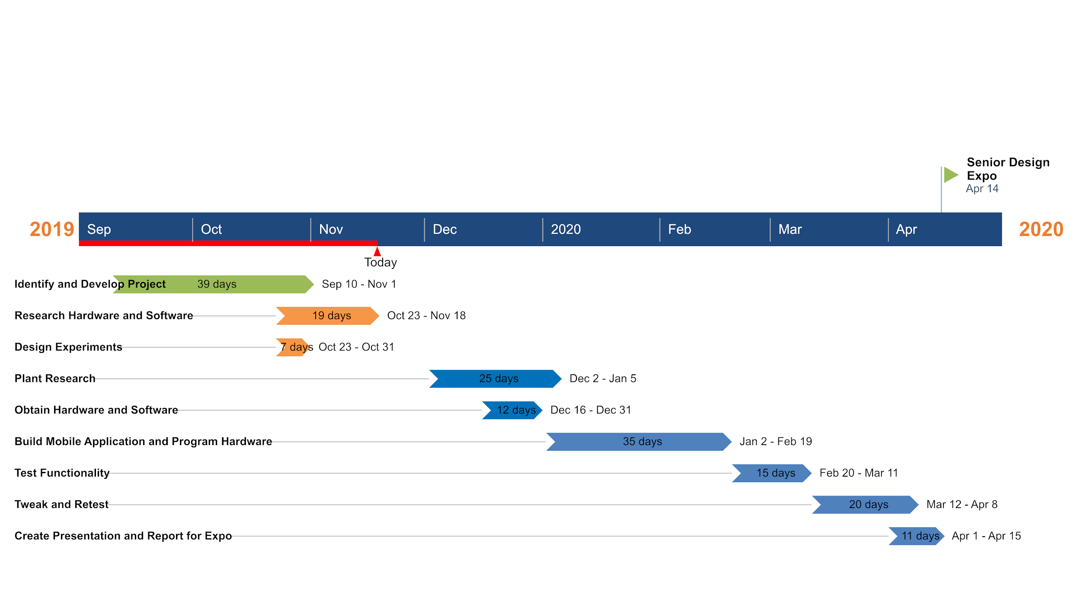
Project Timeline & Milestones

Slide 12
Who is Doing What
Max
Rachael
Obtain necessary Software & Hardware
Implement Preliminary Designs
Mobile App Development
Testing
Plant Research
Task Management
Sensor Experiments
Testing

Slide 13
Expected Demo
Display Board
Explanation of Project
Development process
Results from experiments/evaluation of the project
Prototype including soil and plant
Demonstration of product
Add water until a warning is sent
Have a plant light to trigger light sensor

Slide 14
Any Questions?

